Slide 1


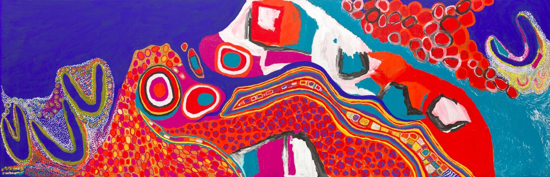

Slide 2
Reflection Activity – Abstracted Land
How does Sally Gabori use abstraction, colour, and scale to communicate her spiritual connection to Country?
How does Tamika Grant-Iramu embed stories of place and identity into her printmaking through texture and motif?
In what ways does Jacqueline Scotcher translate movement and sensory experience into abstract landscape?
How do these three artists use different formal strategies—layering, repetition, colour, and shape—to code their connection to place?

Slide 3
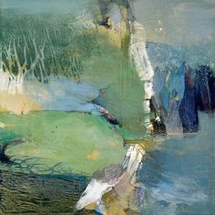
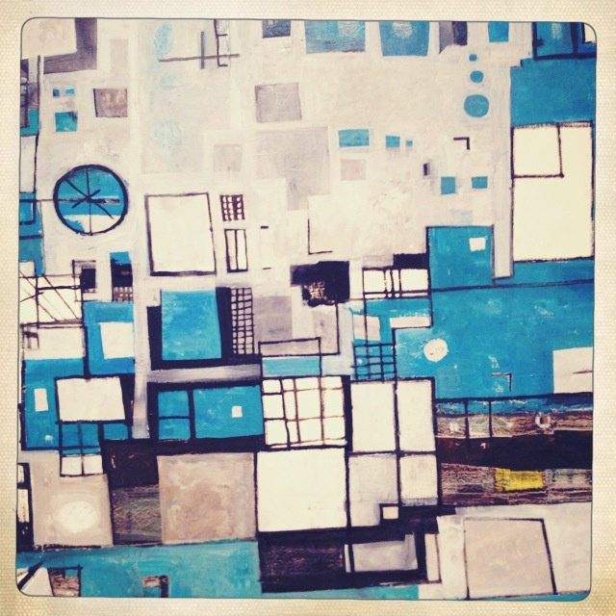
PRACTICAL ACTIVITY – PART A
Task: Create an abstracted painting that represents a familiar or meaningful environment from an aerial, topographical, or symbolic perspective.
Objective: To explore how colour (element) and pattern (principle) can visually communicate a connection to landscape.
Instructions:
Investigate a natural or urban landscape that interests you—this could be local, cultural, or discovered through satellite photography.
Consider shapes, symbols, or signs that express boundaries, memories, movement, or relationships to place.
Use a limited colour palette to communicate mood, memory, season, or cultural identity.
Explore changing perspectives—bird’s-eye view, map-like arrangements, or elevation.
Apply unconventional techniques like layering, smearing, gouging, using sticks or hands to express movement and personal engagement.
Materials: Acrylic, gouache, watercolour, collage, or mixed media with natural textures (e.g. sand, rubbings, bark)
Formal Context: Consider how aerial perspective, mark repetition, and spatial balance shape rhythm in the painting.
Cultural Context: Reflect on how landscapes carry identity, memory, and ancestral connection across cultures.

Slide 4
Researching: How did you react to stimulus?
Insert clear image of artwork
Crop the image to frame the work (nothing in the background)
Developing: How did you generate solutions to visual problems? Insert a photograph/s detail of the artwork below
Reflecting: How did you consider ideas and information, media techniques and processes?
Evaluate: How successful was the experiment? Why?

Slide 5
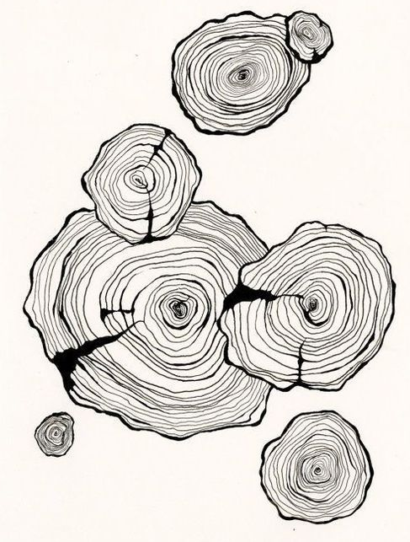
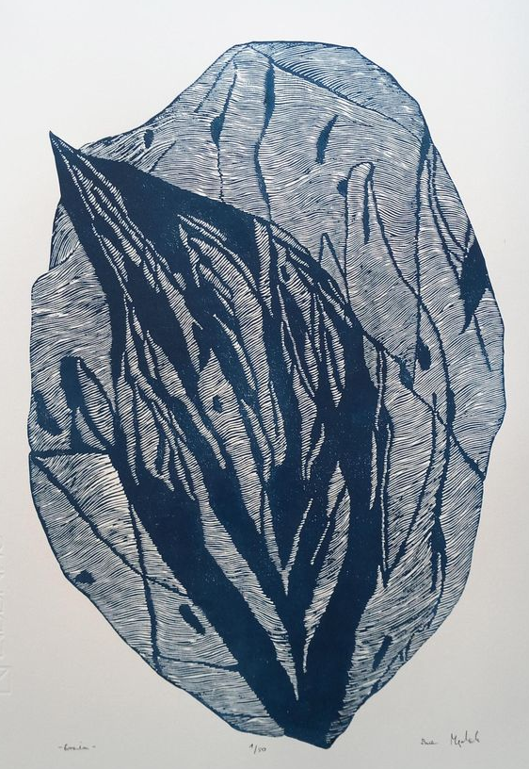
PRACTICAL ACTIVITY – PART B
Task: Design a printmaking motif that symbolically reflects a meaningful landscape or environmental connection.
Objective: To communicate landscape through simplified natural forms, repetition, and rhythm.
Instructions:
Identify a significant feature in your chosen place (e.g. river bend, tree root, mountain outline, path).
Reduce it into a simple motif or symbol.
Carve the design into a foam or lino plate.
Create prints using layering, repetition, or mirrored patterns.
Formal Context: Explore how repetition, symmetry, and direction affect rhythm and flow in design.
Cultural Context: Reflect on how your motif relates to personal or cultural identity, and how nature carries story or memory.

Slide 6
Researching: How did you react to stimulus?
Insert clear image of artwork
Crop the image to frame the work (nothing in the background)
Developing: How did you generate solutions to visual problems? Insert a photograph/s detail of the artwork below
Reflecting: How did you consider ideas and information, media techniques and processes?
Evaluate: How successful was the experiment? Why?

